Slide 1

TARGET FOLDER
SRNTGT027
Koashva Research Facility, SRN
SECRET - DCS WORLD
REL TO COALITION
SECRET - DCS WORLD
REL TO COALITION

Slide 2

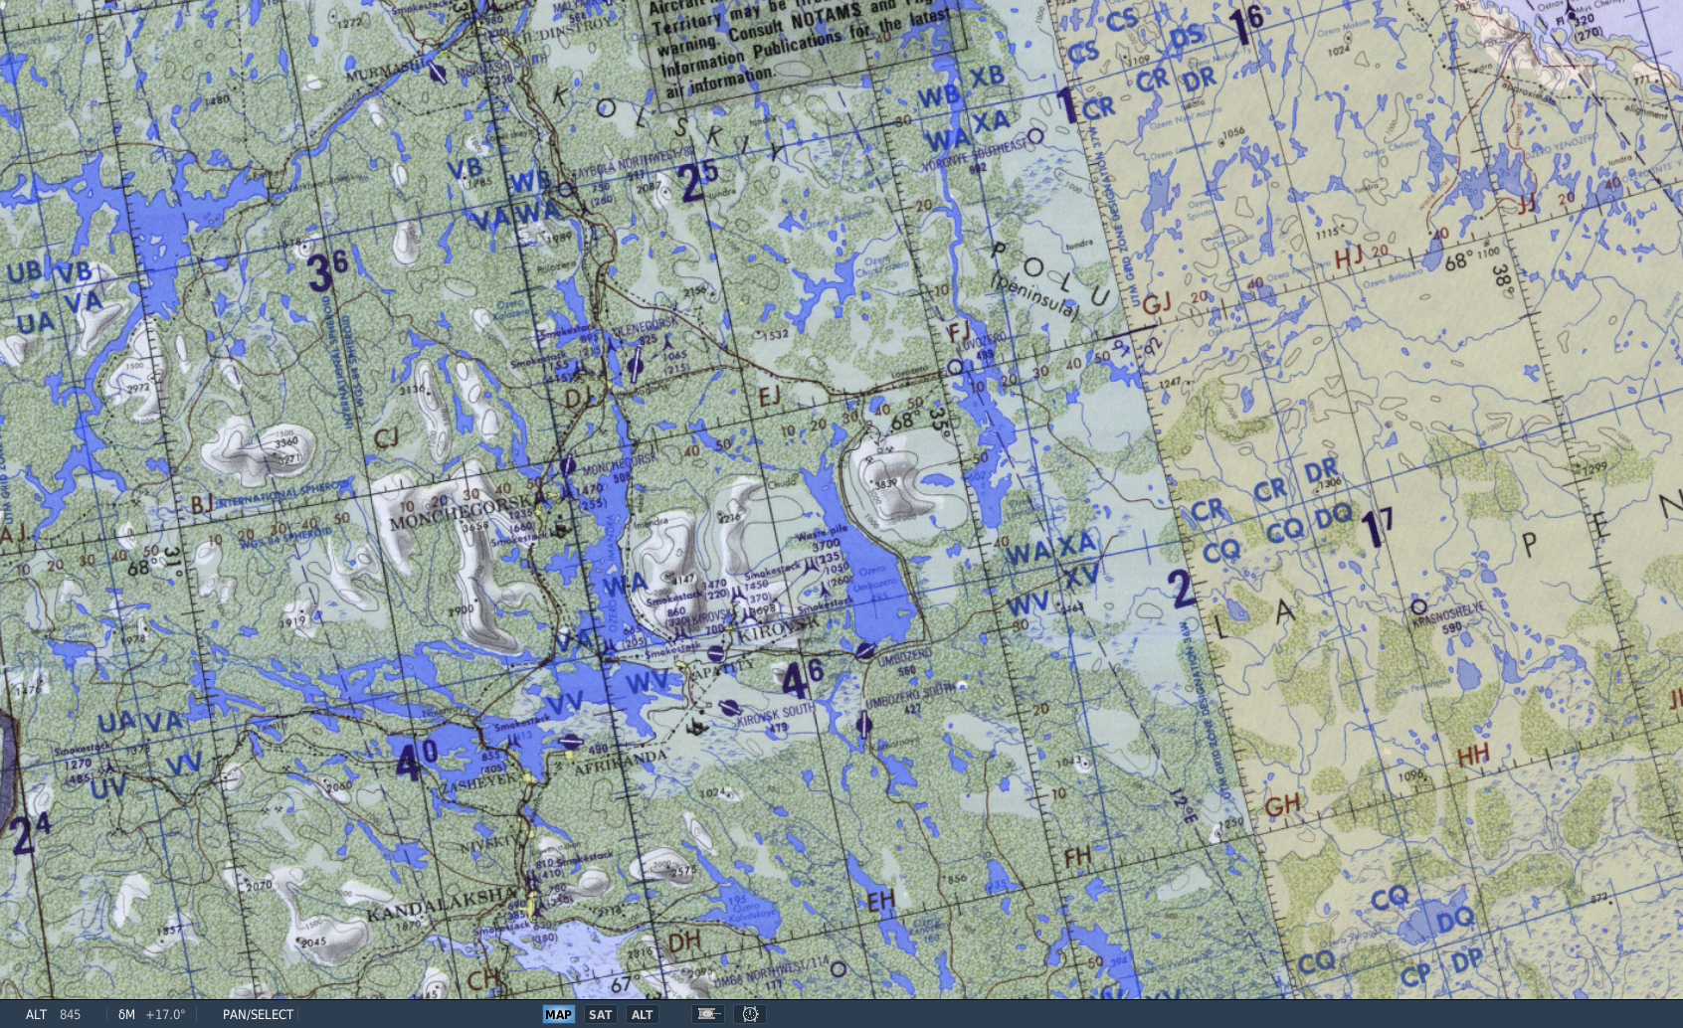
Koashva Research Facility, SRN
OPAC CLASSIFIED REL TO CJTF-23
JOINT OPERATIONS GRAPHIC [X]
MAP
OVERVIEW
BE: SRNTGT027 CATCODE: 1
MIDB GEO: N 67 29.532 E 034 18.662
ICOD: 2011-JUL-09 DOI:2011-JUL-09
DECL ON: 2061-JUL-07
N
Koashva Research Facility SRNTGT027
.

Slide 3
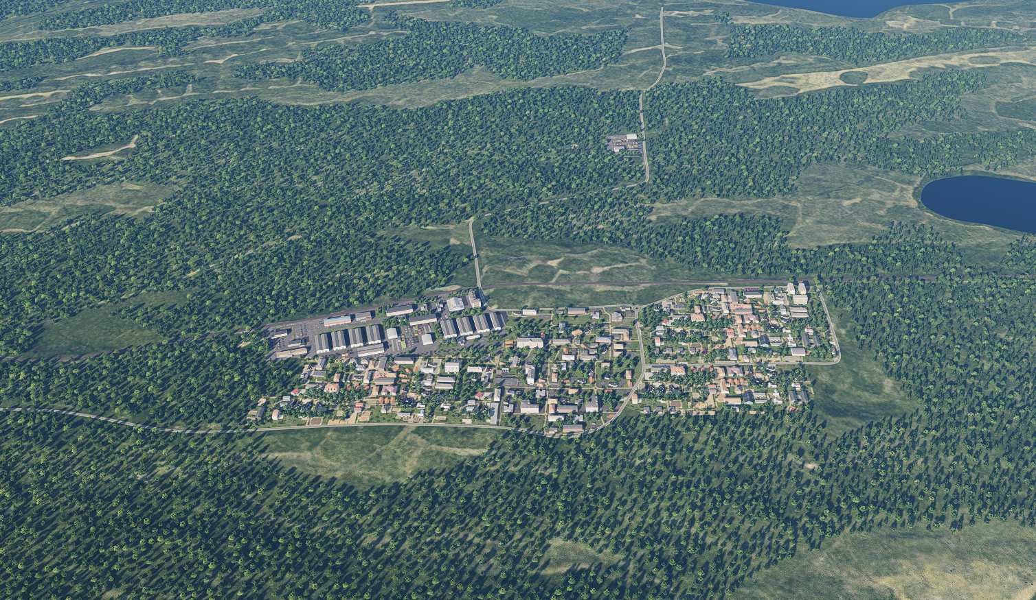
Koashva Research Facility, SRN
OPAC CLASSIFIED REL TO CJTF-23
FACILITY OUTLINE GRAPHIC 1/1
MAP
OVERVIEW
BE: SRNTGT027 CATCODE: 1
MIDB GEO: N 67 29.532 E 034 18.662
ICOD: 2011-JUL-09 DOI: 2010-JUN-01
DECL ON: 2061-JUL-07
N
Chemical Storage Yard
Koashva Research Facility SRNTGT027 (underground)
Power substation

Slide 4
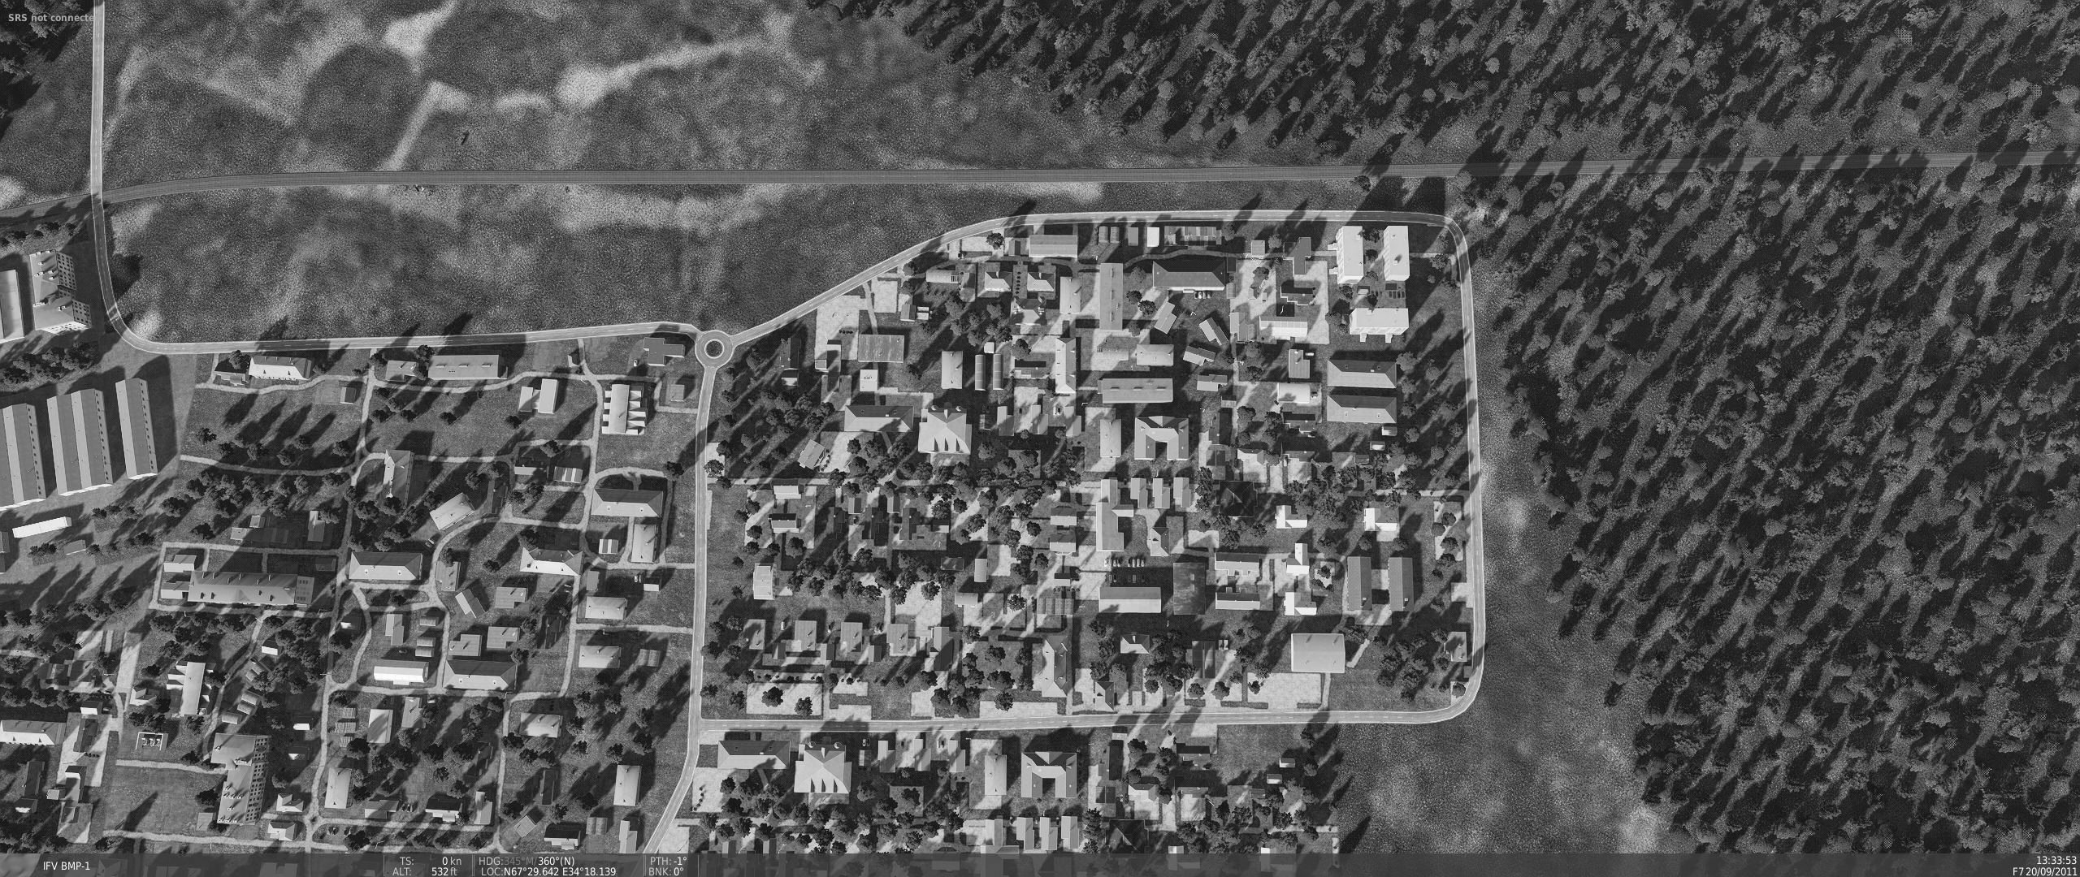
Koashva Research Facility, SRN
OPAC CLASSIFIED REL TO CJTF-23
DESIRED POINT OF IMPACT GRAPHIC 1/1
MAP
OVERVIEW
BE: SRNTGT027 CATCODE: 1
MIDB GEO: N 67 29.532 E 034 18.662
ICOD: 2011-JUL-09 DOI: 2010-JUN-01
DECL ON: 2061-JUL-07
N
DPI: SRNTGT027-B
UNDERGROUND COMPLEX ENCRANCE
N 67 29.556 E 034 18.500
DPI MSL: 550 FT
Underground complex believed to be located 60+ feet beneath residential area.
DPI: SRNTGT027-A
UNDERGROUND COMPLEX ENTRANCE
N 67 29.546 E 034 18.849
DPI MSL: 550 FT

Slide 5
Koashva Research Facility, SRN
OPAC CLASSIFIED REL TO CJTF-23
WEAPONEERING OPTIONS 1/1
MAP
OVERVIEW
BE: SRNTGT027 CATCODE: 1
MIDB GEO: N 67 29.532 E 034 18.662
ICOD: 2011-JUL-09 DOI:2011-JUL-09
DECL ON: 2061-JUL-07
DPI | DESCRIPTION | TLE | WARHEAD | GUIDANCE | DESIRED EFFECT | IMPACT ANGLE | FUZING
A | MS GREY BRICK BUILDING WITH DORMER WINDOW W | CAT 3 | 1000 lbs | METRIC | BLAST | 60-90 | 25ms
B | MS RED ROOF BUILDING WITH TERRACES TO SE | CAT 3 | 1000 lbs | METRIC | BLAST | 60-90 | 25ms

Slide 6
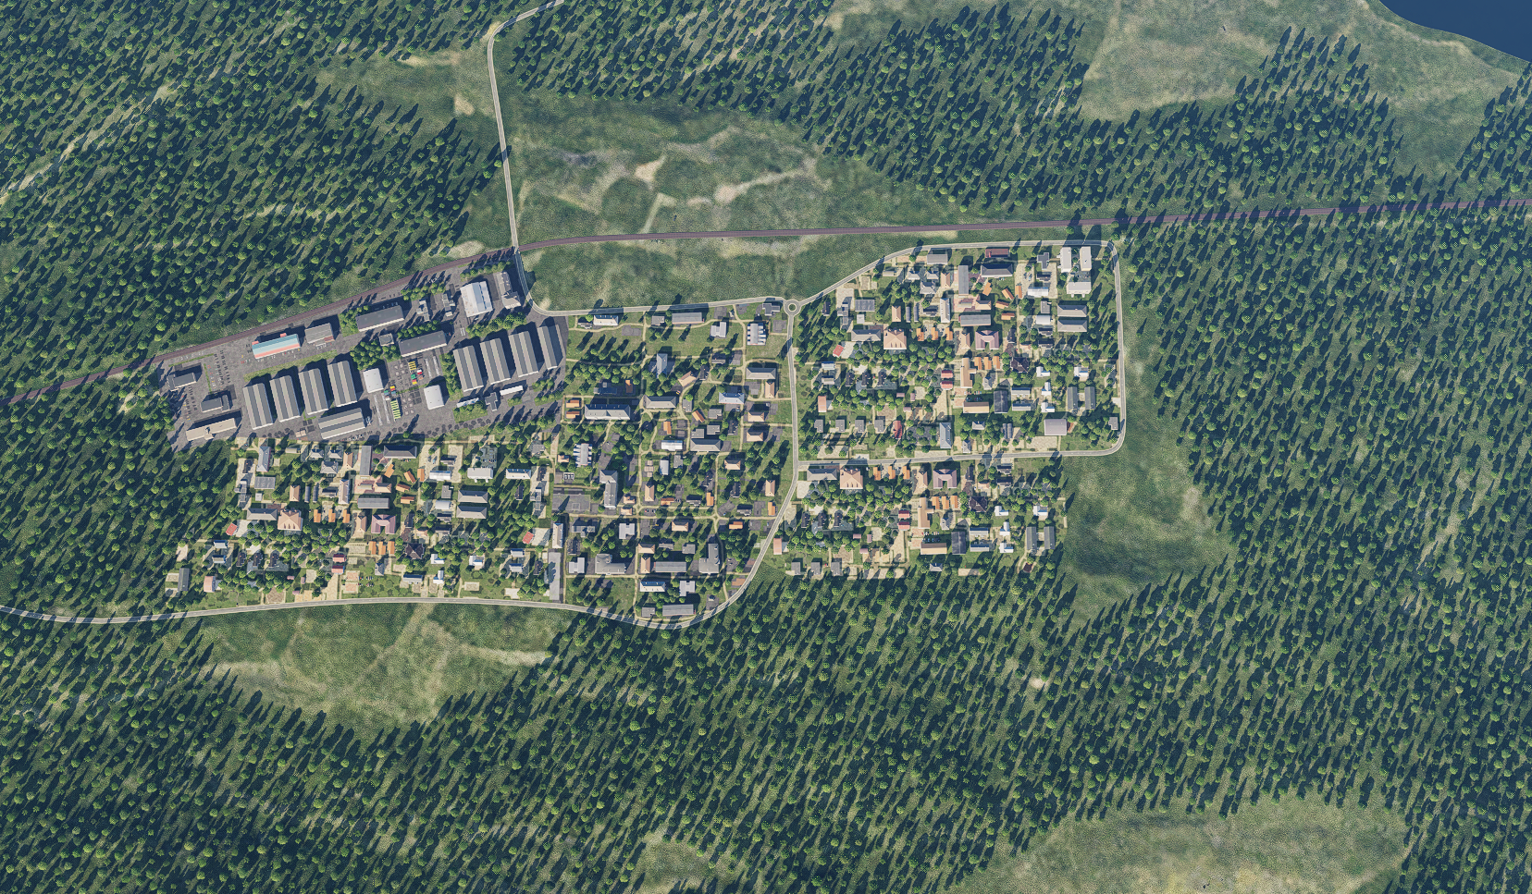
Koashva Research Facility, SRN
OPAC CLASSIFIED REL TO CJTF-23
COLLATERAL DAMAGE ESTIMATION GRAPHIC 1/1
MAP
OVERVIEW
BE: SRNTGT027 CATCODE: 1
MIDB GEO: N 67 29.532 E 034 18.662
ICOD: 2011-JUL-09 DOI:2010-JUN-01
DECL ON: 2061-JUL-07
CER 250M / 812FT
N
DPI B
DPI A
NCC: RESIDENTIAL AREA SURROUNDING TARGET
CDE5, FAH TO MINIMIZE IMPACT

Slide 7
Koashva Research Facility, SRN
OPAC CLASSIFIED REL TO CJTF-23
COLLATERAL DAMAGES ESTIMATION 1/1
MAP
OVERVIEW
BE: SRNTGT027 CATCODE: 1
MIDB GEO: N 67 29.532 E 034 18.662
ICOD: 2011-JUL-09 DOI:2011-JUL-09
DECL ON: 2061-JUL-07
COLLATERAL DAMAGES WITHIN A 500M RADIUS
DESCRIPTION |  | CATCODE | MIDB GEOS | LOCATION | REMARKS
CIVILIAN INDUSTRIAL UNITS |  | 13 |  | 100FT | Potential Civilian Casualties
NO STRIKE ENTITIES WITHIN A 500M RADIUS
NSE ID | DESCRIPTION | CATCODE | MIDB GEOS | LOCATION | REMARKS

Slide 8
Koashva Research Facility, SRN
OPAC CLASSIFIED REL TO CJTF-23
BATTLE DAMAGE ASSESSMENT GRAPHIC 1
MAP
OVERVIEW
BE: SRNTGT027 CATCODE: 1
MIDB GEO: N 67 29.532 E 034 18.662
ICOD: 2011-JUL-09 DOI: 2010-JUN-01
DECL ON: 2061-JUL-07
POST-STRIKE
PRE-STRIKE
N
TARGET OBJECTIVE
DAMAGE/CHANGE ASSESSMENT
DPI:[XXXXXX]
BDA REMARK: [CLASSIFICATION] [DISSEMINATION] Assessment: Physical Damage/change, Collateral Damage, Functional Damage/change, Munitions Effectiveness, Reattack Recommendation, Additional/Collateral Effects

Slide 9

ACRONYMS
ACRONYM | MEANING | DEFINITION
BE | Basic Encyclopedia Number | Alpha/numeric code unique to an installation for incorporation within various national and tactical systems.
CATCODE | Category Code | The data Element that classifies the function and purpose of an installation or a facility.
MIDB | Modernized Integrated Database | A database comprised of information on facilities of military significance, military forces, and related equipment.
ICOD | Intelligence Cut Off Date | The date of the latest intelligence data inputted to a feature.
DOI | Date of Image | Date on which a geospatial or intelligence-related image was captured.
CE | Critical Element | An element of an entity or object that enables it to perform its primary function.
PV CHAR | Physical Vulnerability Characteristic | Standardized alphanumeric code describing the physical and structural properties of a target.
JDPI | Joint Desired Point of Impact | A unique, alphanumeric coded aimpoint identified by a three dimensional mensurated point. It represents a weapon or capability desired point of impact or penetration.
CE90 | Circular Error at 90% | 90 percent confidence level in the horizontal plane.
LE90 | Linear Error at 90% | 90 percent confidence level in the vertical dimension
MSL | Mean Sea Level | Elevation above Earth reference geoid.
AGL | Above Ground Level | Elevation above ground surface.
NCC | Nearest Collateral Concern | Closest non-targeted structure, area, or entity near a planned point of impact that may be at risk of unintended damage during a military strike.
CER | Collateral effects radius | Radius within which collateral damage might happen based on the weapon's characteristics, the target environment, and other operational factors.
CDE | Collateral damage estimate | Systematic process used in military targeting to evaluate the potential for unintended damage or harm to non-combatant entities, structures, or personnel as a result of a planned strike.
NSE | No Strike Element | Specific entities, locations, or objects that are protected from intentional targeting under the Law of Armed Conflict (LOAC) or by operational policy.

